Slide 1
Weekly report: Tower structure
Week number: 05
Date: 28/10/2025
Supervisor: Prof. Faber
Group members:,Mohammed Eldemerdash, Ibrahim Mostafa ,Kirollos Ghaly
Speaker: Kirollos Ghaly (760171)
28/10/2025
1
Group members: Ibrahim Mostafa, Mohammed Eldemerdash, Kirolls Ghaly
Tower structure team/ Optimus Syria

Slide 2
List of contents
Check Buckling analysis of the tower
Check Local Buckling .
28/10/2025
Group members: Ibrahim Mostafa, Mohammed Eldemerdash, Kirolls Ghaly
Tower structure team/ Optimus Syria

Slide 3
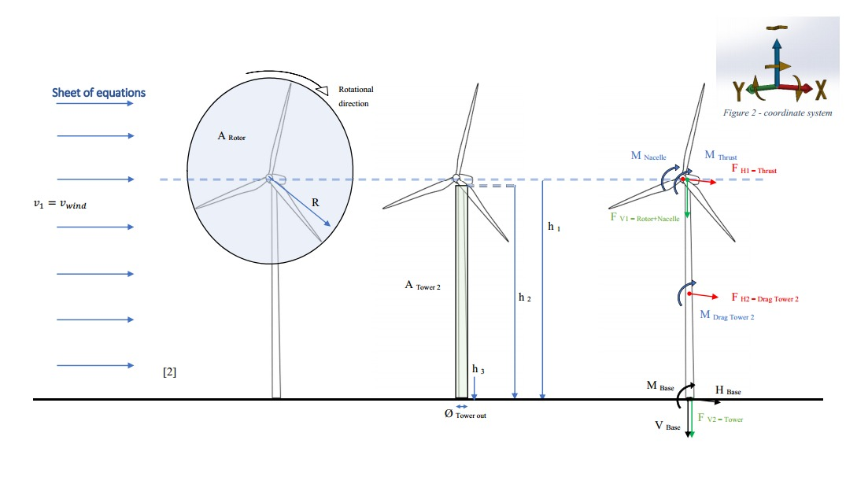
Loads calculations and stress analysis
Source: Prof. Dr.-Ing. Torsten Faber lectures
28/10/2025
Group members: Ibrahim Mostafa, Mohammed Eldemerdash, Kirolls Ghaly
Tower structure team/ Optimus Syria

Slide 4
Calculations
Data
Air density | ρ_air | 1.225 [kg/m³]
Steel density | ρ_steel | 7850 [kg/m³]
wind speed | v-1 | [m/s]
Steel S355 yield strength | f_k | 335 [N/mm²]
Material safety factor | γ_M | 1.1
Stress concentration factor | γ_k | 1
Number of blades | B | 3
Gravitational acceleration | g | 10 [m/s2]
Diameter _rotor | D | 160 [m]
Hub diameter | D- hub | [m]
Total vertical load | FV = F_{v1} + F_{v2} | 9807 [KN]
Tower height | h-tower | 100 [m]
Tower outer diameter | D-out | 4.8 [m]
Tower inner diameter | D-in | 4.69 [m]
Nacelle mass | m-nacelle | 240000 [kg]
Rotor mass | m-blade | 110,000 kg
28/10/2025
Group members: Ibrahim Mostafa, Mohammed Eldemerdash, Kirolls Ghaly
Tower structure team/ Optimus Syria

Slide 5
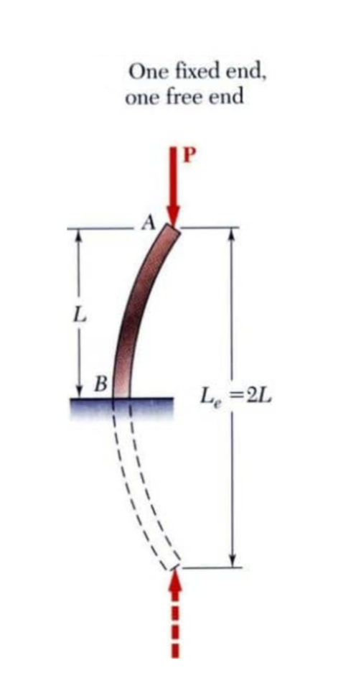
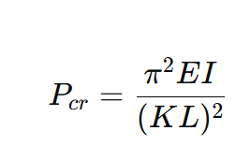
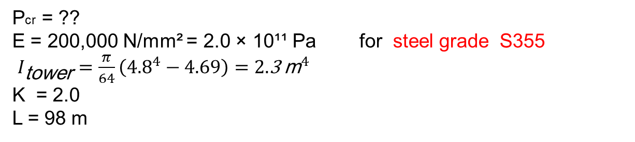
Buckling Calculations
Pcr​ = Critical buckling load
E = Modulus of elasticity of the material
I = Moment of inertia of the cross-section
K = Effective length factor
L = Height of the tower
Pcr​ = ??
E = 200,000 N/mm² = 2.0 × 10¹¹ Pa for steel grade S355
$I_{\text{tower}}=\frac{π}{64}\left({4.8}^{4}−4.69\right)=2.\text{3} {\text{m}}^{4}$
K = 2.0
L = 98 m
Reference to data assumptions:
-Load and Dynamic team
-IEC 61400-1 Overview
28/10/2025
Group members: Ibrahim Mostafa, Mohammed Eldemerdash, Kirolls Ghaly
Tower structure team/ Optimus Syria

Slide 6
Buckling Calculations
Pcr​ = Critical buckling load
E = Modulus of elasticity of the material
I = Moment of inertia of the cross-section
K = Effective length factor
L = Height of the tower
Pcr​ = 118.2MN​ P allowable = Pcr​ / safety factor
Safety factor = 1.5 depending on standards like IEC 61400 or DNVGL-ST-0126.
P allowable = 118.2/1.5 = 78.8MN Actual Axial Load (P actual ) = Total vertical forces
FV= FV1+FV2 = 9807 KN = 9.8 MN
If Pactual ≤ P allowable, the tower is safe.
9.8 MN ≤ 78.8 MN , the tower is safe.
Reference to data assumptions:
-Load and Dynamic team
-IEC 61400-1 Overview
28/10/2025
Group members: Ibrahim Mostafa, Mohammed Eldemerdash, Kirolls Ghaly
Tower structure team/ Optimus Syria

Slide 7
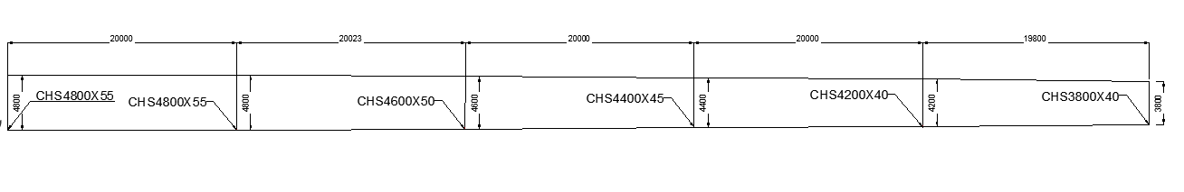
Sketch of tower dimensions
28/10/2025
Group members: Ibrahim Mostafa, Mohammed Eldemerdash, Kirolls Ghaly
Tower structure team/ Optimus Syria

